Slide 1
SMACNA National Update
Scott Vidimos
President
Vidimos Inc.
East Chicago, Indiana
Notes:
I have been the SMACNA board liaison to St. Louis for the last two years and appreciate the opportunity to visit you again. I want to thank Noah for having the interest in making sure that all of his contractors understand the resources available to them thru SMACNA’s website.
I am always energized after coming to St. Louis to talk with contractors or read about what the chapter and local are doing to expand their market. Your contractors are passionate about their businesses. I don’t’ think there’s another area in the country that has an approach to capturing residential work like St. Louis. The recent article in SMACNews about Architectural Sheet Metal Systems making their own ACM and MCM panels shows that St. Louis contractors are willing to make the necessary investment to expand their capabilities and increase business.
I don’t want to underplay my abilities but I am contractor like you. I may not be able to answer all of the questions that you may have but will jot them down and get back to Noah with answers so that he may disseminate them as needed.

Slide 2
SMACNA National Update
SMACNA Subscription eLibrary
37 SMACNA Standards & CAD Drawings
Members Receive One Free Seat and Full Access to All the Standards
Member Employees Are Eligible to Access the Standards
Members May Purchase Additional Seats at 85% Discount
Notes:
I’ve been asked to give you an introductory tour of SMACNA’s cloud-based Subscription eLibrary. It is one of our benefits of being SMACNA members. How many of you have logged in to your library? As a SMACNA member, you and your employees have one free subscription to all 37 SMACNA Technical Standards and nearly 200 architectural CAD drawings. Your subscription entitles one person to view one book at a time. You may view multiple books at the same time, but two people cannot work in the same book simultaneously. You may purchase additional annual subscription seats at a substantial member discount. There are also quantity discounts available.

Slide 3
SMACNA Subscription eLibrary
Features
Online Access Through SMACNA Home Page
Works on Computer/Phone/Tablet
Powerful Search Engine
Member Printing Privileges
Copy and Paste into Reports
Use E-notes to Record Project Details
24/7 Access Anywhere
Notes:
You access your library through the SMACNA home page –www.smacna.org– Access it on you computer, phone, or tablet. It has a powerful search engine and allows for member printing as well as copying and pasting privileges. And it has 24/7 access. I’ll touch on the E-notes ability in a moment.

Slide 4
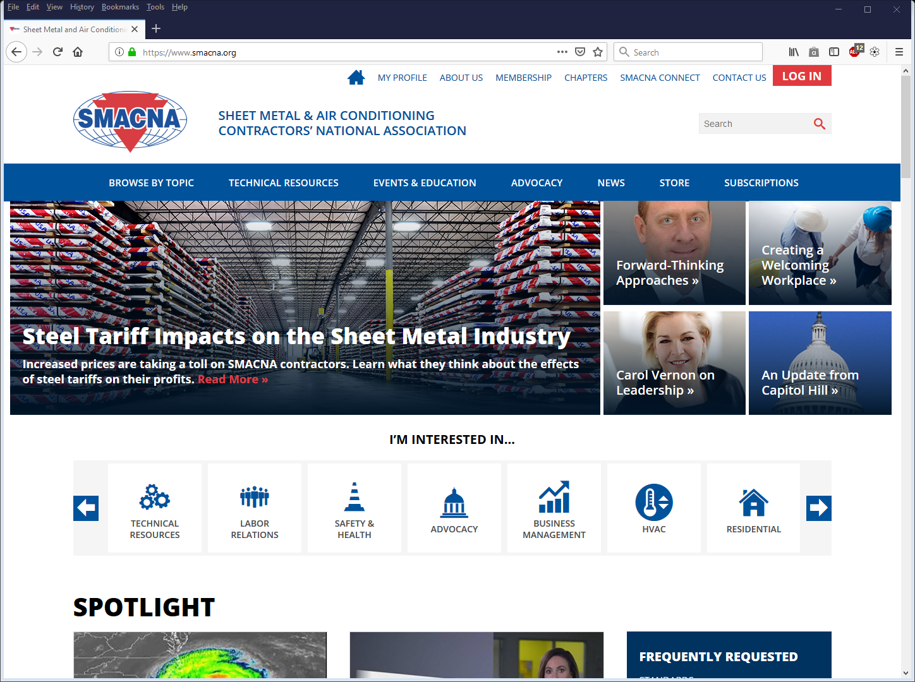
LOG IN at www.smacna.org
If user is already logged in, subscriptions tab
will take them to the elibrary. If not logged in, user
will be prompted to smacna.org login page.
Notes:
Log in on the SMACNA home page. [Note the red Subscriptions box on the screen.}

Slide 5
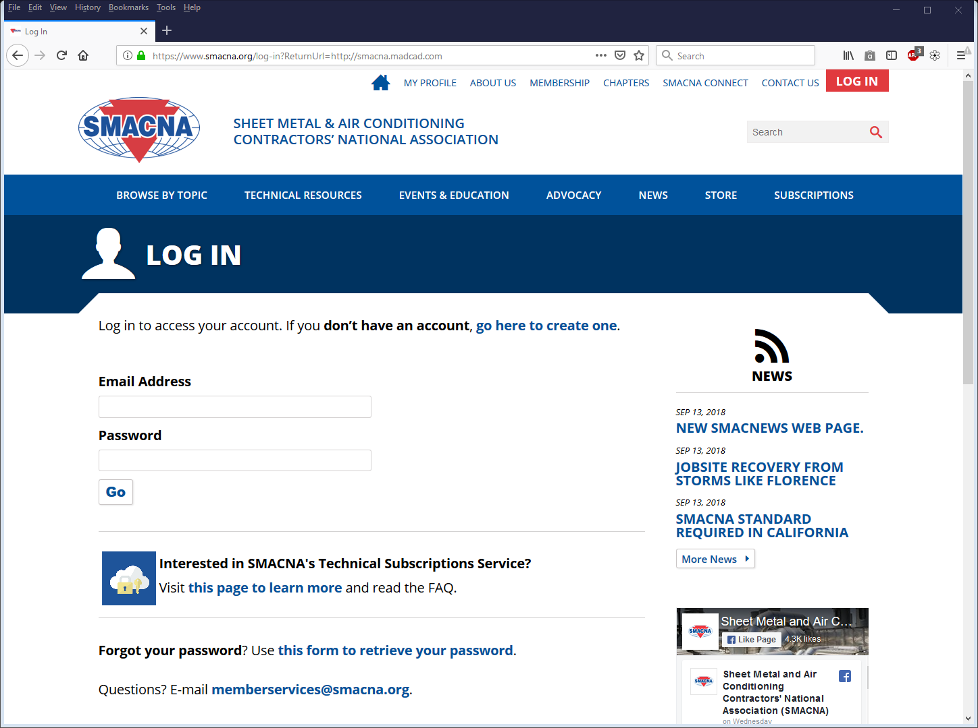
Log In with Email Address and SMACNA Password
Notes:
Log in with your email address and SMACNA password.

Slide 6
Forgot Password?
Email: membership@smacna.org
SMACNA Credentials for Employees?
Email: membership@smacna.org
Notes:
Forgot your password? Email membership@smacna.org. Use the same address to get credentials for your employees. Sarah Mauck at SMACNA is extremely helpful and responsive in getting people set up to use the eLibrary as well as answer questions.

Slide 7
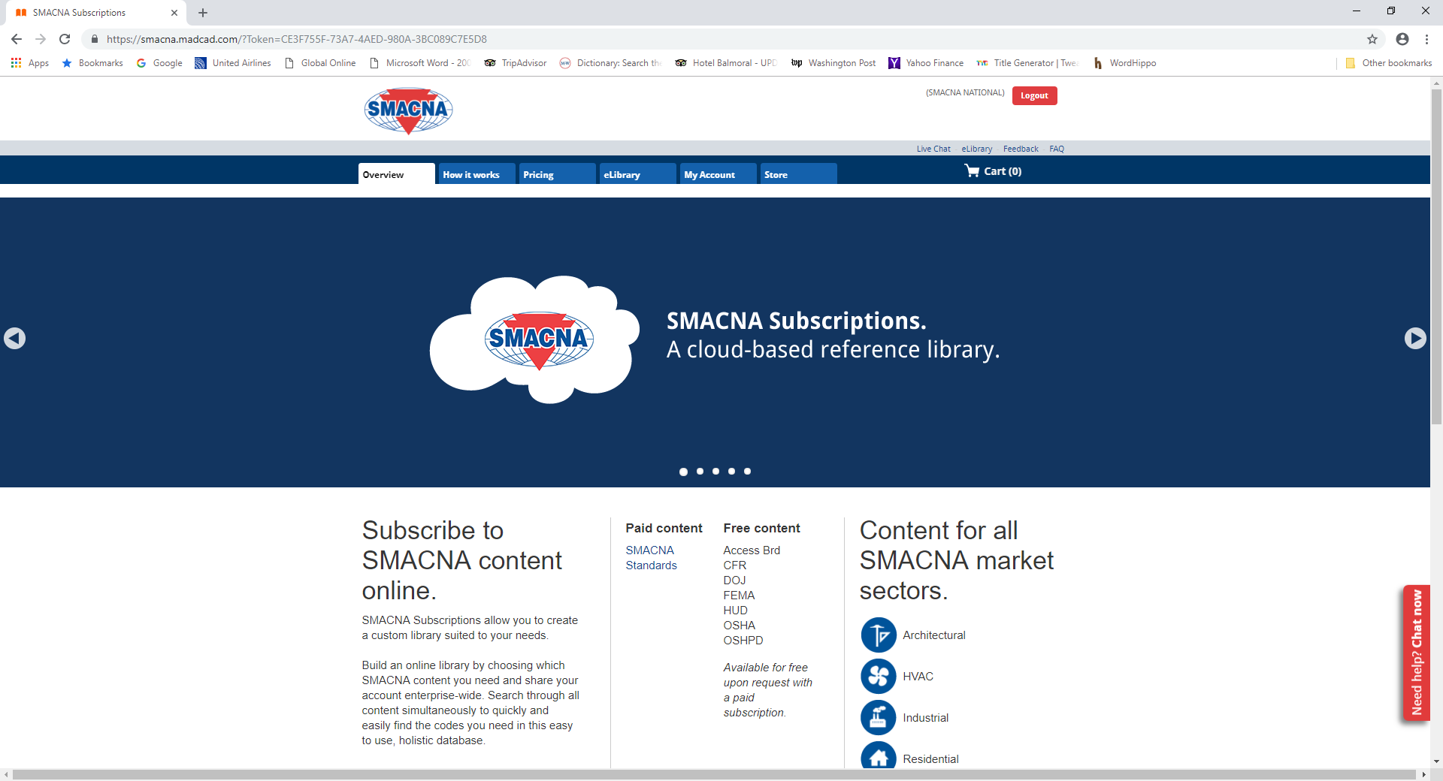
SMACNA Subscription eLibrary Home Page
Notes:
Once you’ve logged in, you’ll see this landing page. Note the red box that says eLibrary. Click on it and it will take you to your library.

Slide 8
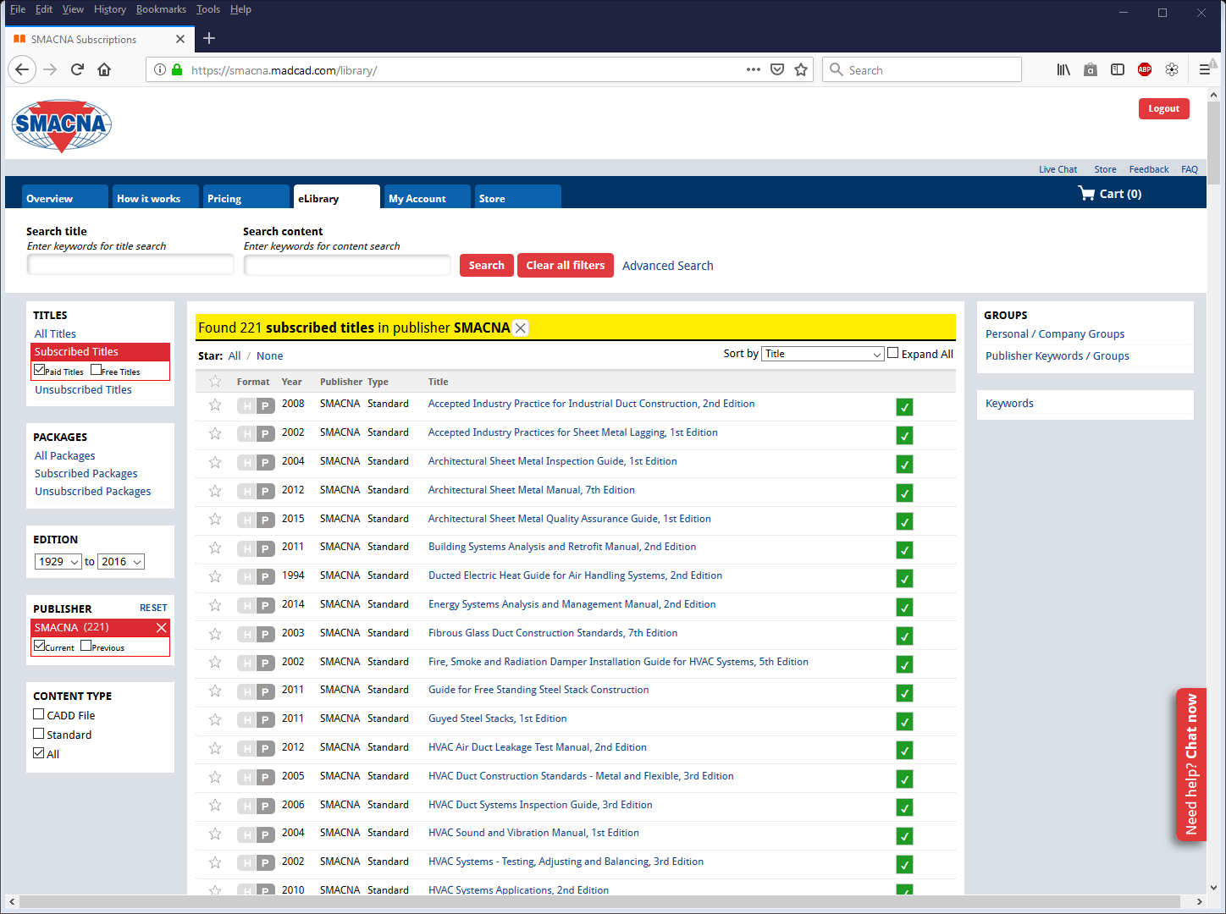
SMACNA Subscription eLibrary List of Titles
Notes:
Here are your list of titles. Note the green checks to the right. They indicate the titles to which you have access.

Slide 9
Navigate the SMACNA Subscription eLibrary
Click on the Book Title To:
Access the Table of Contents
Select a Chapter to Navigate Inside the Book
Use Content Search to Search Within the Title
Search Within Multiple Titles
Notes:
Click on any book title and you’ll be able to access the table of contents, navigate to a chapter inside the book, search inside the book, or search within multiple titles.

Slide 10
Search the SMACNA Subscription eLibrary
Use content search to search
within standards
Use title search to find
particular standards
Click any title to go to the
Table of Contents
Various filters help
Users narrow down
results
Notes:
The notes on this page indicate various ways to navigate the library. [Point out title search and content search boxes. Show where to click to get the table of contents.]

Slide 11
SMACNA Subscription eLibrary Features
Search for Keywords Within a Title
Print and Save the PDF
Print Sections of a Title and Insert into Your Document
Members Are Entitled to Print the Complete Standard
Notes:
The search engine is very strong and fast. Members can print the entire standard, as well as sections to insert into a document.

Slide 12
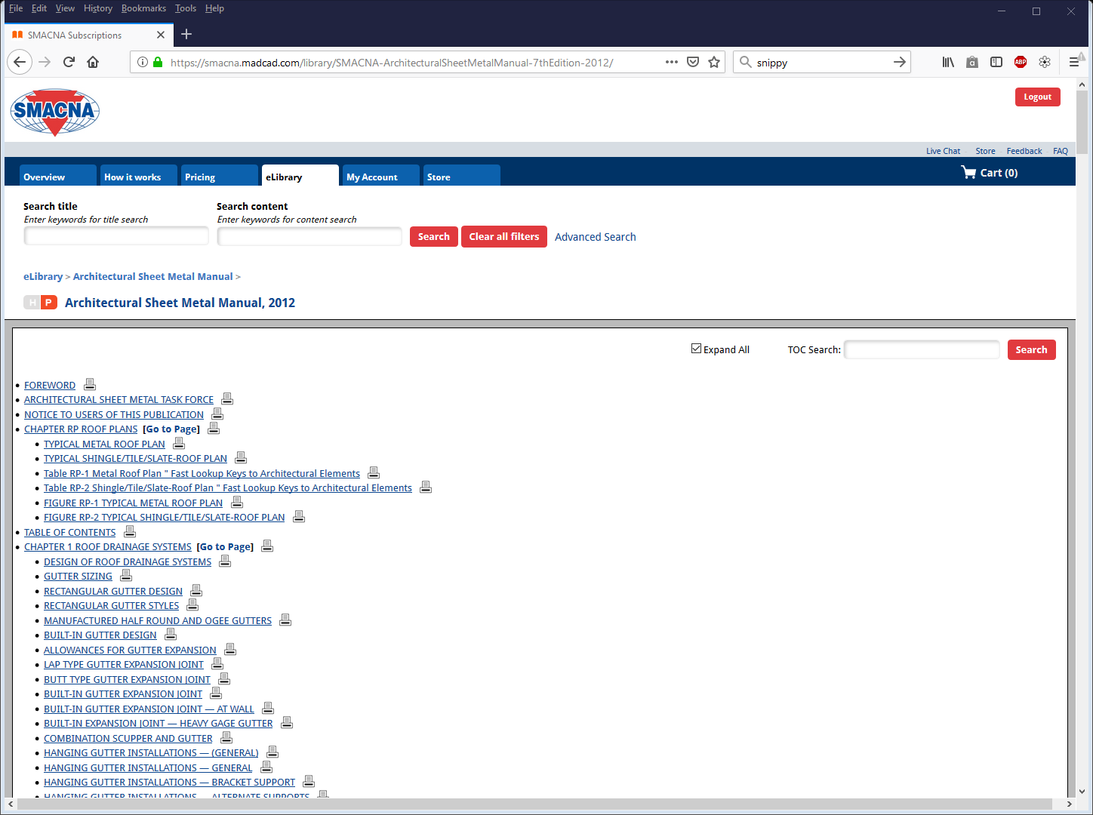
Search for keywords within
Architectural Sheet Metal Manual
Print / Save as PDF
Check to
see subsections
In Table of
Contents
Search for keywords
within
Table of Contents
Click to any subsection
to go the particular page
Notes:
This page shows the expanded view of the Architectural Manual. [Point out the features: Search content, chapter subsection, expand subsections, search keyword in the table of content.]

Slide 13
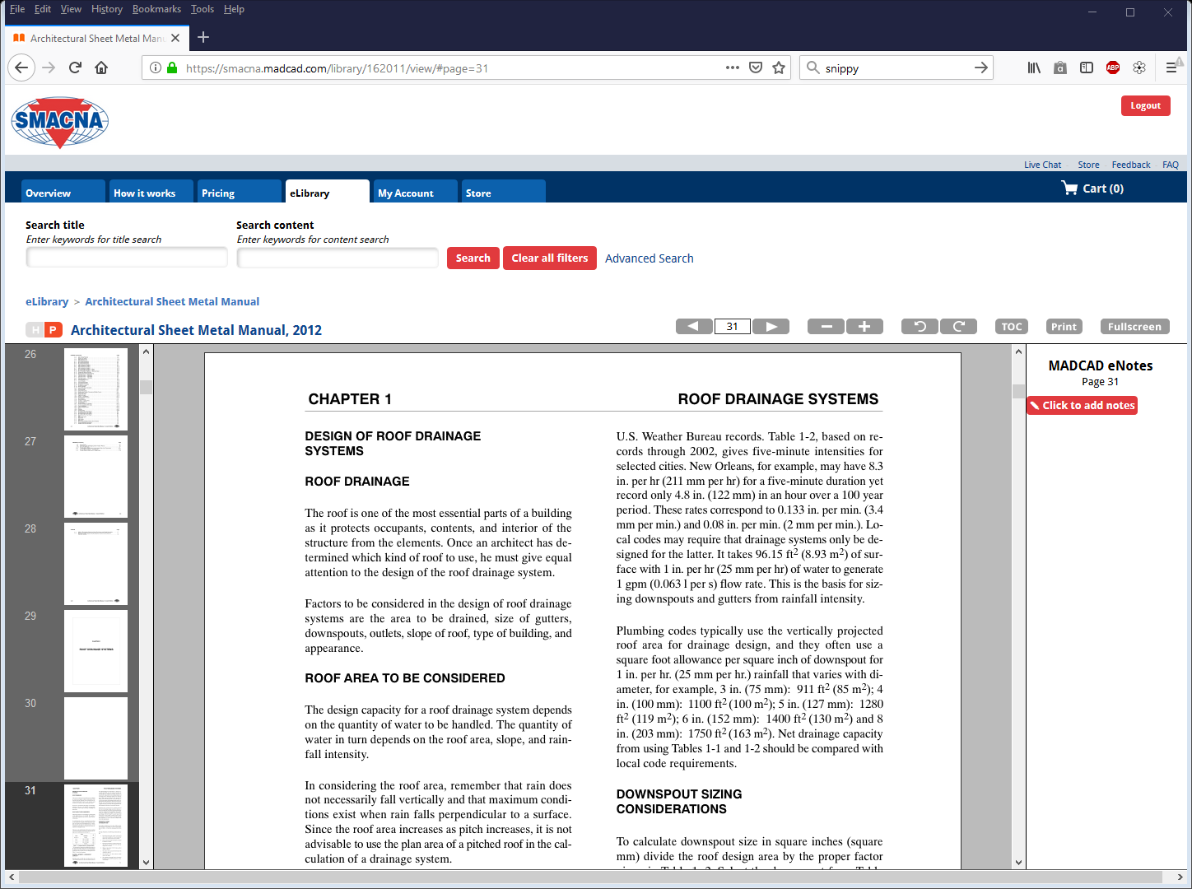
How a Title Appears on Your Screen
Navigate previous
next pages
Back to
Table of Contents
Zoom in/out
Rotate page
Print /
Save as PDF
Page thumbnails allow
users to scroll up/down
within the standard
eNotes allows users to add notes to particular pages of a standard
Notes:
Here’s a sample page of the Architectural Sheet Metal Manual. See the page thumbnails on the left. Navigate through the book using the icons at the top right including printing or saving as a PDF. And add eNotes.

Slide 14
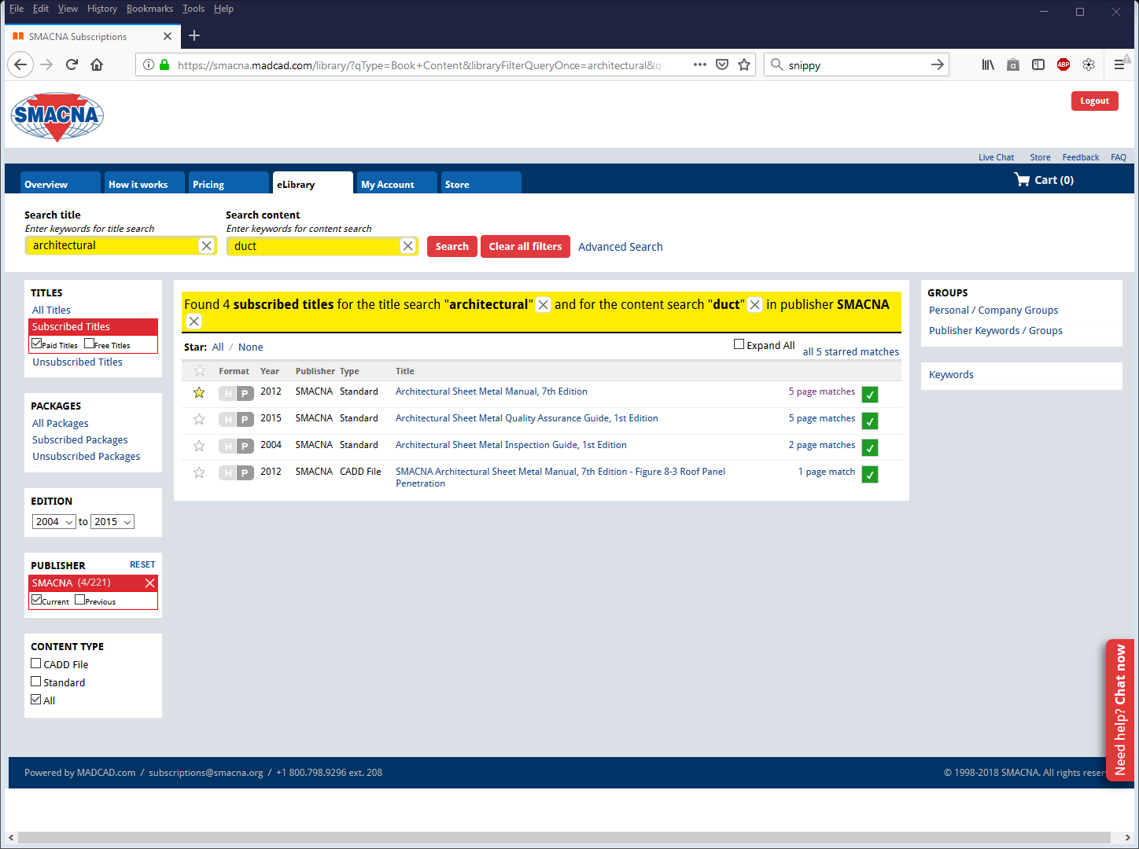
Powerful Search Engine Searches by Title and Content
Searching for titles
that has the keyword
“architectural”
Content search for keyword “duct”
Click to the title to see the 5 page matches
Notes:
This page shows the results of a search where any reference to ‘duct’ within any standard containing the work ‘architectural’ is found. [Point out where the search arrows are located.]

Slide 15
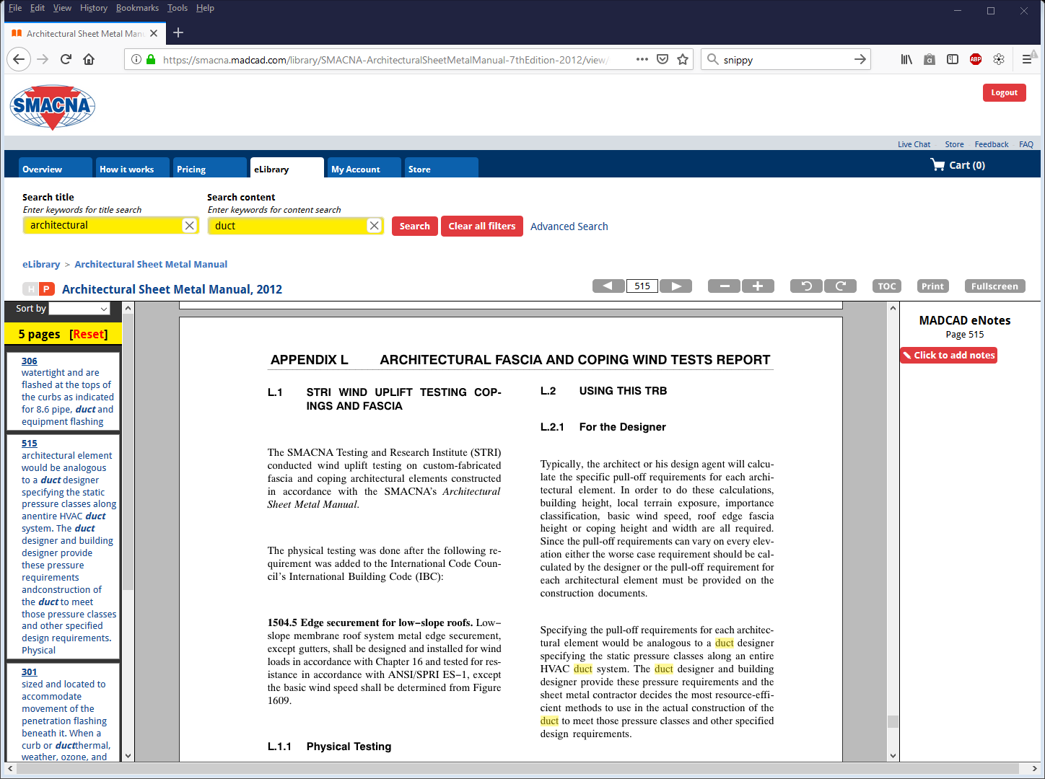
Search Results
Click X to clear title search
Click X to clear content search
Click to thumbnails to
jump to pages with
matching search results
Search results
are highlighted
in yellow
Notes:
For example, here are search results for the word “duct” in the Architectural Sheet Metal Manual. It is highlighted in yellow. The thumbnail gives you a preview of the page. Click on the thumbnail to access that page.

Slide 16
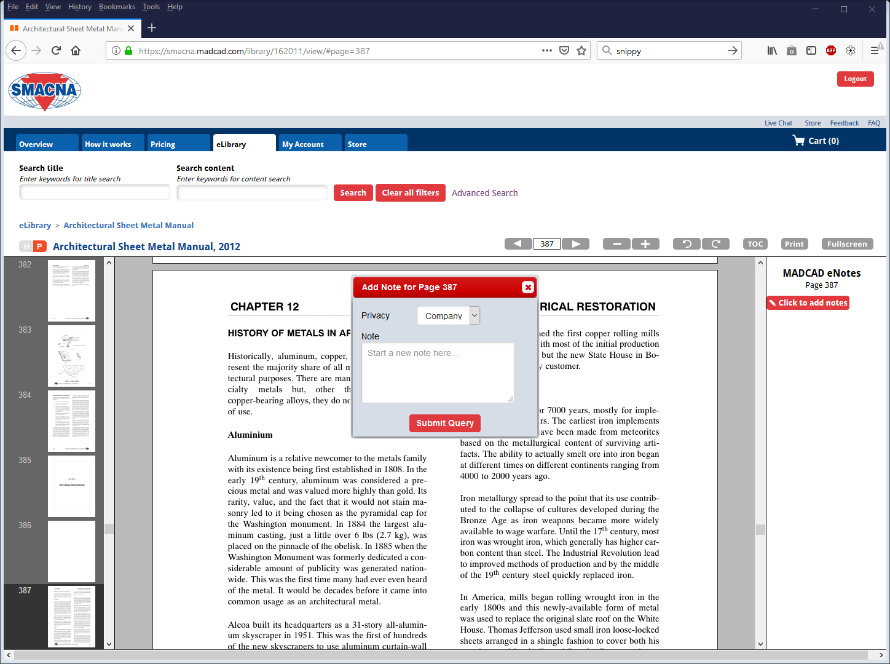
Add eNotes
Private or Shared Within the Company
Add personal (can’t be seen by others) or company (can be seen by others) notes
To add your note to a page, click to
add notes
Notes:
See the notes section at the right of the screen. Clicking on the ‘add notes’ icon pops up the box in the center of the screen. You can add a note that will be seen by the entire company or add a note that will be seen only by you.

Slide 17
SMACNA Subscription eLibrary Store
Member company’s primary contact can purchase additional seats.
Member discount is 85% off of list price.
Notes:
Each company’s primary contact for SMACNA can purchase additional seats. You might want to buy more seats for some of the more popular books. (go to next page) Note that the additional seats allow more than one person to view the same title at one time. Otherwise, each person from your office has free access to all of the technical standards.
I do have the current lists of List Prices and Discounted Prices with me. For instance, the HVAC Duct Construction Standards lists for $164.67. The annual subscription fee would be $24.70. I will give Noah a the price list after the presentation for those that are interested.

Slide 18
SMACNA Subscription eLibrary Questions ??
FAQ eLibrary (on website)
Online Chat (Monday – Friday 9 a.m. to 6 p.m. EST)
Toll Free Number: 1-800-798-9296 x208
Email: subscriptions@smacna.org
Notes:
If you have questions about the store, there are several ways you can get more information. This is also how you can go about adding seats. It is also possible to add seats by going thru MadCad but I would suggest working thru SMACNA since they are so good at taking care of the contractors.
I also want to mention that specific technical questions can be fielded by SMACNA’s Technical Department by email or phone. The people in the department do a wonderful job about answering technical inquiries.

Slide 19
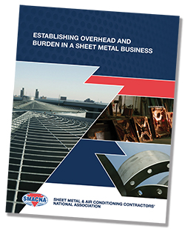
SMACNA National Update
Contactors Operations Manual – 2 New Titles
Covers the non-financial areas involved when operating a contracting business.
Notes:
Note that in addition to these two books, the Contractors Operations Manual covers information technology, materials and inventory, personnel policies, and job costing. Note that all of these are FREE to view or print to SMACNA contractors thru Business Management section of the website.
I printed the Burden manual to read on my flight and can leave it with Noah for anyone that would like it.

Slide 20
SMACNA National Update
White Papers
(on website)
Virtual Design and Construction Practice:
Benefits, Challenges, and Proven Strategies for AEC Team
Successful Customer Service Practices for HVAC Service and Retrofit Contractors
Off-Site Construction, Modularization, and Sheet Metal Prefabrication: Trends, Current Practice, and Recommendations
Notes:
These free white papers are available to members on the SMACNA website. Topics include: Virtual Design. Customer Service. Off-Site Construction

Slide 21
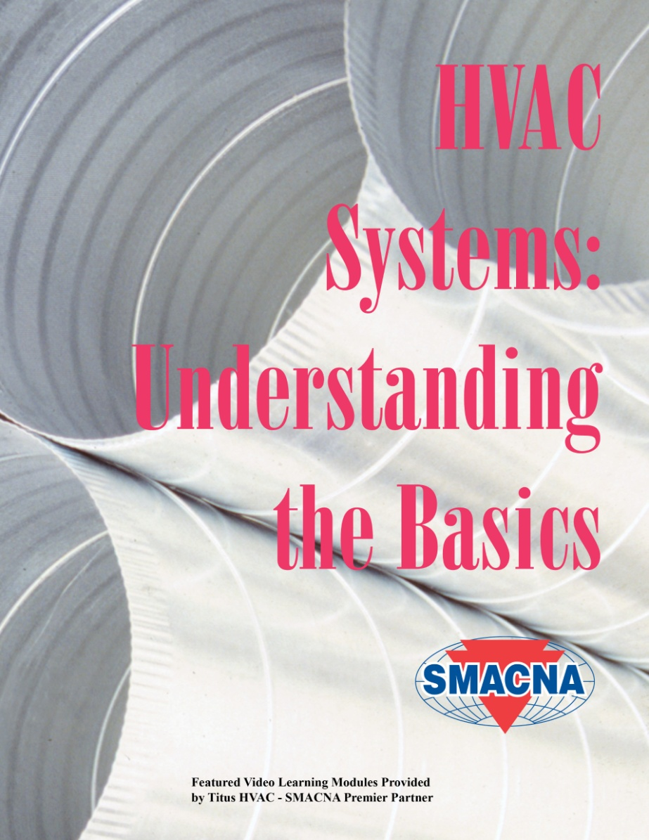
National SMACNA Update
Notes:
This non-technical manual provides an overview of HVAC Systems used in residential, commercial, and institutional buildings. It has been updated and includes video learning modules throughout the document so users can click a link and view a video on specific topics. This is a great training tool for new hires and for support staff.

Slide 22
SMACNA App Update
SMACNA HVAC Duct Construction App
Updated for iOS compatibility
Web version free to SMACNA Members Only
SMACNA’s Downspout & Gutter Sizing Calculator
Easily and accurately size downspout and gutters per SMACNA’s “Architectural Sheet Metal Manual.”
Notes:
The HVAC Duct Construction App has been updated for iOS compatibility. Search for “SMACNA HVAC DCS” on Google Play and on the App Store. the The Downspout App is SMACNA’s newest app and is proving quite popular. Both the downspout and DCS apps free to members and are on the SMACNA website.
Not listed here are the Duct Air Leakage app and the SMACNA’s Round Industrial Duct Construction App which are also available.

Slide 23
New Horizons Foundation
2019 Projects
Engaging Employees
The Internet of Things (IoT)
The Exiting Executive – Managing the Impact on the Organization
Tools and Material Management Research Update
Notes:
New Horizons is a group that funds specific business management topics. They already have published nearly 40 papers that are available for purchase. They can be seen at newhorizonsfoundation.org. I have a list of their papers that I can give to Noah for those that are interested in learning more.
These are the projects the New Horizons Foundation is looking at for 2019.
New Horizons Foundations is working on compiling their papers in a form to make them more easily accessible. There is a program at this year’s convention covering that topic.

Slide 24
Discussion…
Notes:
There are also a number of industry specific papers available on site as well as access to some of SMACNA’s past webinars.
I encourage you to sign up for access to the eLibrary and also spend some time at SMACNA’s site to review the other educational resources that SMACNA made available to their contractors.
I know this is a lot to absorb in a short time. Do you have any questions?

